Slide 1
Microsoft Azure Fundamentals
Module 3, Section 1
Dr. Tóth Ádám
toth.adam@inf.unideb.hu

Slide 2
Cost management
Notes:
https://learn.microsoft.com/training/modules/describe-cost-management-azure

Slide 3

Factors affecting costs (part 1)
These are some of the factors affecting costs:
1) Resource type | 2) Consumption | 3) Maintenance
Costs are resource-specific, so the usage that a meter tracks and the number of meters associated with a resource, depend on the resource type. | With a pay-as-you-go model, consumption is one of the biggest drivers of costs. | Monitoring your Azure footprint and maintaining your environment can help you identify and mitigate costs that aren’t necessary, such as shutting down underused virtual machines.
Notes:
https://learn.microsoft.com/training/modules/describe-cost-management-azure/2-describe-factors-affect-costs-azure
Azure shifts development costs from the capital expense (CapEx) of building out and maintaining infrastructure and facilities to an operational expense (OpEx) of renting infrastructure as you need it, whether it’s compute, storage, networking, and so on.

Slide 4
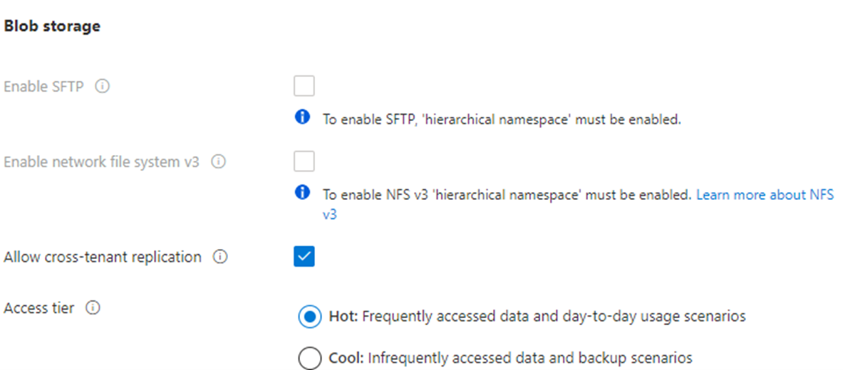
Factors affecting costs

Slide 5
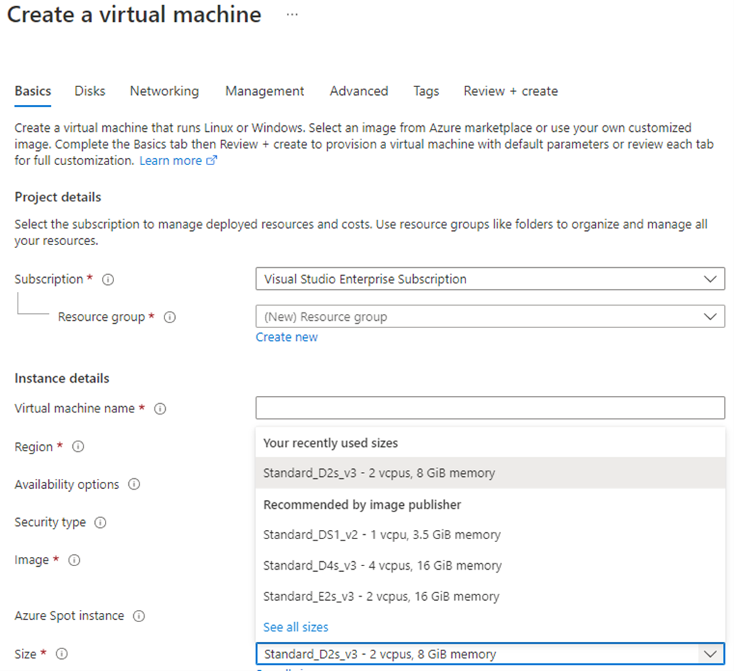
Factors affecting costs

Slide 6
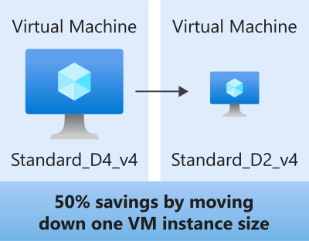
Resize underutilized virtual machines
A common recommendation that you'll find from Azure Cost Management + Billing and Azure Advisor is to resize or shut down VMs that are underutilized or idle.

Slide 7
Factors affecting costs (part 2)
These are some of the factors affecting costs:
4) Geography | 5) Network traffic | 6) Subscription
The same resource type can cost different amounts depending on the geographic area, which has an impact on Azure costs. | While some inbound data transfers are free, the cost for outbound data or data between Azure resources is impacted by billing zones. | The type and configuration of your subscription can also impact your cost. For example, the free trial lets you explore some Azure resources for free.
Notes:
https://learn.microsoft.com/training/modules/describe-cost-management-azure/2-describe-factors-affect-costs-azure

Slide 8

Explore Azure Marketplace
Azure Marketplace allows customers to find, try, purchase, and provision applications and services from hundreds of leading service providers, which are all certified to run on Azure.
Open-source container platforms.
Virtual machine and database images.
Application build and deployment software.
Developer tools.
And much more, with 10,000-plus listings!
Notes:
https://learn.microsoft.com/training/modules/describe-cost-management-azure/2-describe-factors-affect-costs-azure
Connects end users with Microsoft partners, Independent Software Vendors (ISVs), and start-ups that offer solutions and services for Azure.
Azure customers, IT professionals and cloud developers can find, try, purchase, and provision Azure applications and services from certified service providers.
Includes close to 10,000 product listings.
There is also a Marketplace FAQ available at https://azure.microsoft.com/en-us/marketplace/faq/
Azure Marketplace: https://azuremarketplace.microsoft.com/en-us/

Slide 9
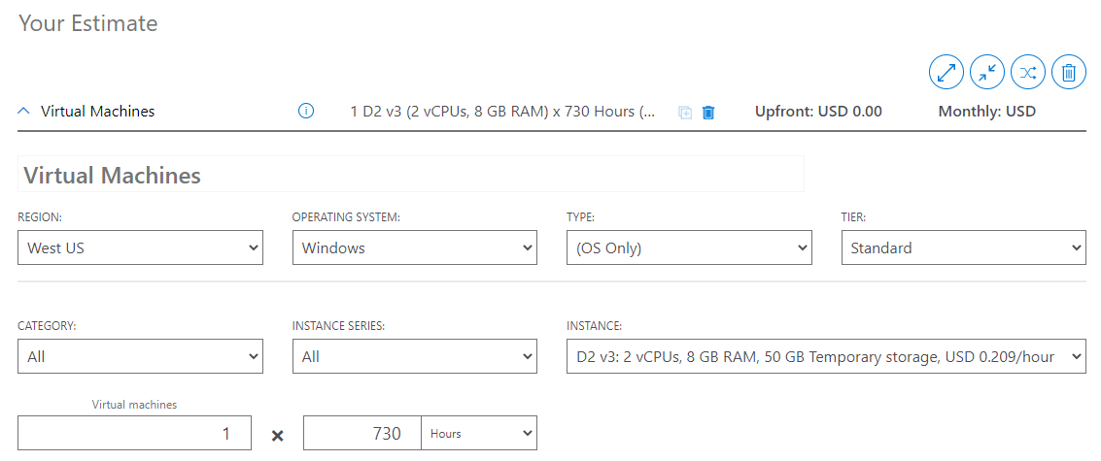
Pricing calculator
The pricing calculator is a tool that helps you estimate the cost of Azure products. The options that you can configure in the pricing calculator vary between products, but basic configuration options include:
Region
Tier
Billing options
Support options
Programs and offers
Azure dev/test pricing
Notes:
https://learn.microsoft.com/training/modules/describe-cost-management-azure/3-compare-pricing-total-cost-of-ownership-calculators
Pricing calculator: https://azure.microsoft.com/en-us/pricing/calculator/
Note: The pricing calculator provides estimates, and not actual price quotes. Actual prices can vary depending upon the date of purchase, the payment currency, and the type of Azure customer.

Slide 10
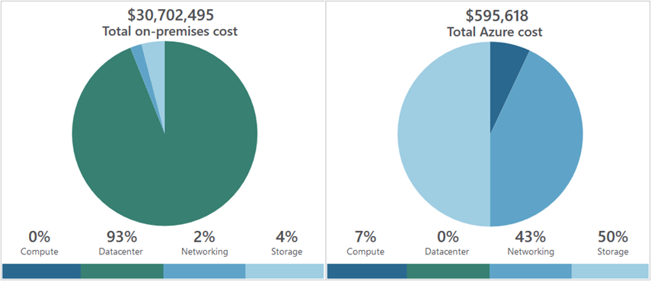
Total Cost of Ownership (TCO) calculator
A tool to estimate cost savings you can realize by migrating to Azure.
A report compares the costs of on-premises infrastructures with the costs of using Azure products and services in the cloud.
Notes:
https://learn.microsoft.com/training/modules/describe-cost-management-azure/3-compare-pricing-total-cost-of-ownership-calculators
TCO calculator: https://azure.microsoft.com/en-us/pricing/tco/calculator/

Slide 11
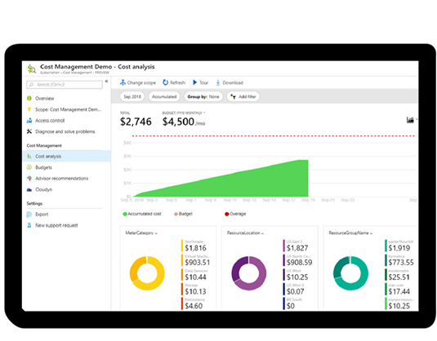
Azure Cost Management
Reporting: Billing reports
Data enrichment
Budgets: Set spend budget
Alerting: When cost exceed limits
Recommendation: Cost recommendations
Notes:
https://learn.microsoft.com/training/modules/describe-cost-management-azure/6-describe-azure-tool
Note: For more information about Cost Management, go to https://azure.microsoft.com/en-us/services/cost-management/

Slide 12
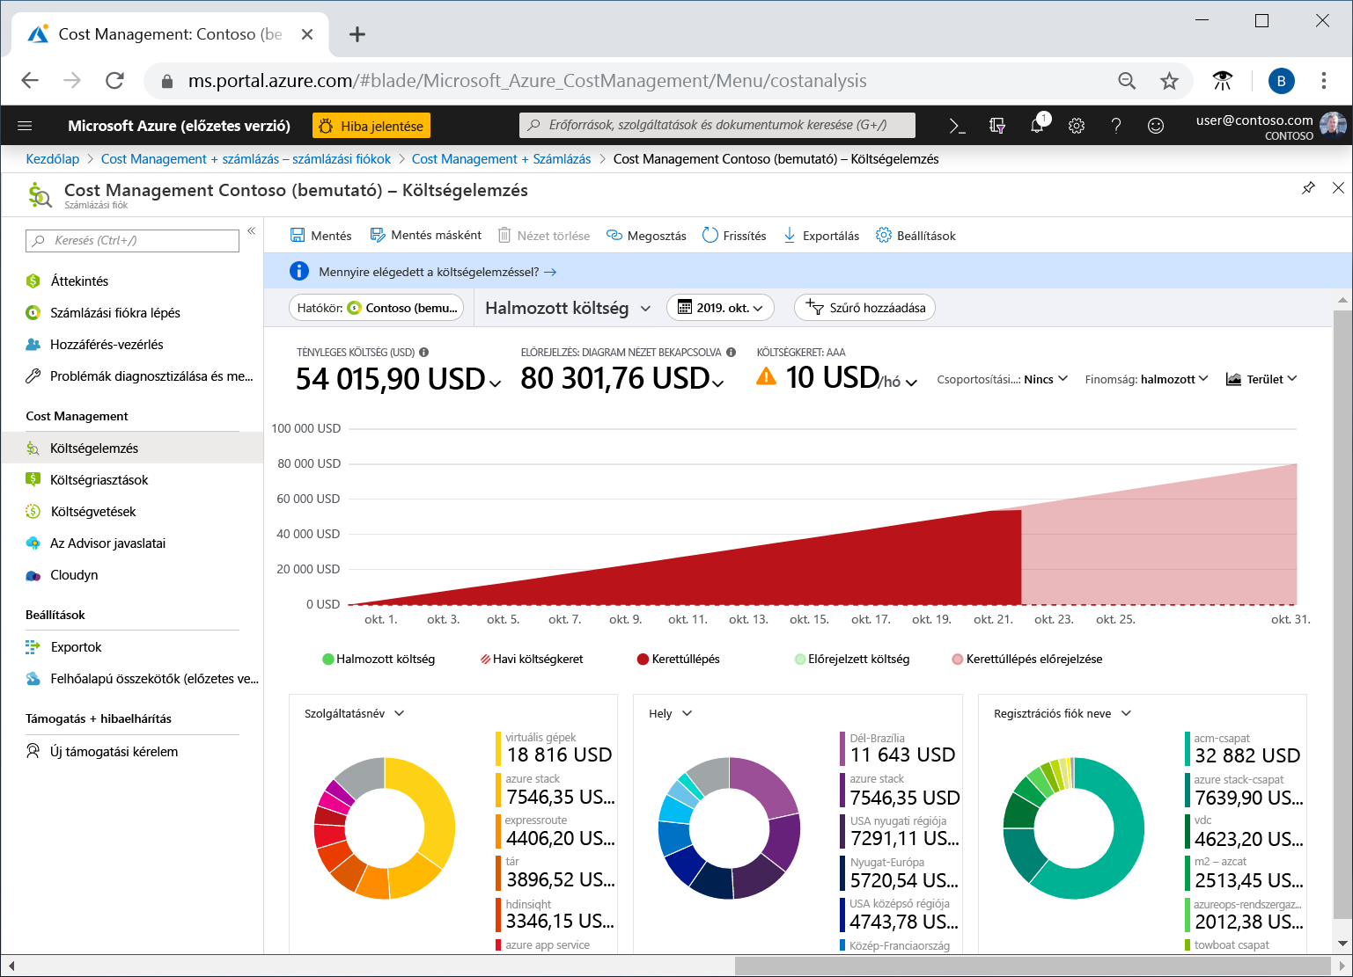
Azure Cost Management

Slide 13
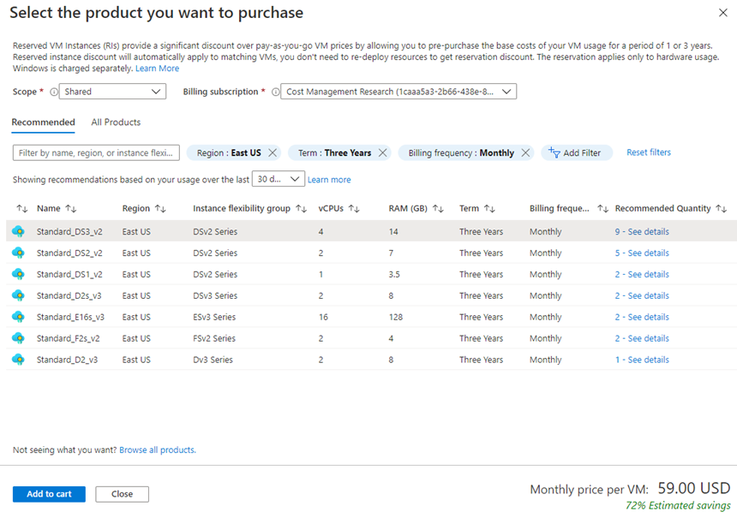
Azure Reservations
Azure Reservations offers discounted prices on certain Azure services. Azure Reservations can save you up to 72 percent as compared to pay-as-you-go prices.

Slide 14
Cost alerts
The three types of alerts that may show up are:
Budget alerts
Credit alerts
Department spending quota alerts

Slide 15
Budget alerts
Budget alerts notify you when spending, based on usage or cost, reaches or exceeds the amount defined in the alert condition of the budget.
Credit alerts: Credit alerts notify you when your Azure credit monetary commitments are consumed.
Department spending quota alerts: Department spending quota alerts notify you when department spending reaches a fixed threshold of the quota.

Slide 16
Budgets
A budget is where you set a spending limit for Azure:
You can set budgets based on a subscription, resource group, service type, or other criteria

Slide 17


Tags
Provides metadata for your Azure resources.
Logically organizes resources into a taxonomy.
Consists of a name-value pair.
Very useful for rolling up billing information.
OR
owner: joe
department: marketing
environment: production
cost-center: marketing
Notes:
https://learn.microsoft.com/training/modules/describe-cost-management-azure/7-describe-purpose-of-tags
Tags: https://learn.microsoft.com/azure/azure-resource-manager/management/tag-resources

Slide 18
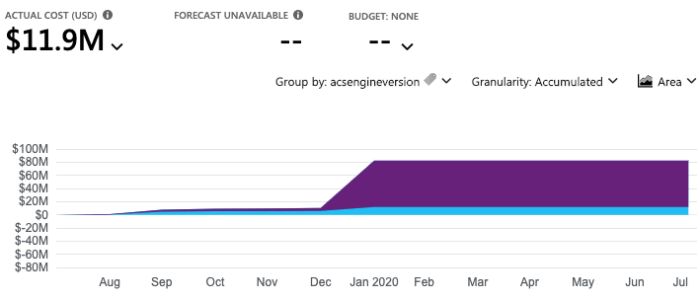
Applying tags
Tags help you manage costs associated with the different groups of Azure products and resources. You can apply tags to groups of Azure resources to organize billing data.

Slide 19
Other recommendations
Save on licensing costs, some examples:
Choose cost-effective operating systems: Many Azure services provide a choice of running on Windows or Linux. It's useful to compare pricing to see whether you can save money.
Use Azure Hybrid Benefit to repurpose software licenses on Azure: If you've purchased licenses for Windows Server or SQL Server, and your licenses are covered by Software Assurance, you might be able to repurpose those licenses on VMs on Azure. Some of the details vary between Windows Server or SQL Server.

Slide 20
Questions
Which feature of Azure would you use to help logically organize resources into a taxonomy?
Select the correct option.
Azure Resource Locks
Azure Advisor
Azure Policy
Azure Tags

Slide 21
Questions
2. What’s the best method to estimate the cost of migrating to the cloud while incurring minimal costs?
Migrate a small sample to the cloud and track costs over time.
Use the Total Cost of Ownership calculator to estimate expected costs.
Migrate to the cloud, but track usage closely using tags to rapidly understand costs.

Slide 22
Questions
3. The Azure pricing calculator provides:
Select the correct option.
A bill for the selected configurations of products and services used in the past month.
A means to save money by committing to selected configurations of products and services over one or three years.
An estimate of the costs associated with selected configurations of products and services.
A tool to compare on-premises costs to Azure products and services.

